Slide 1
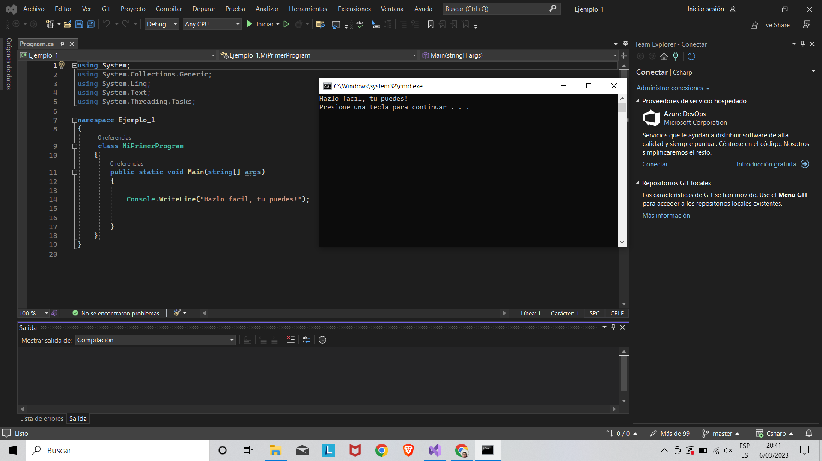

Slide 2
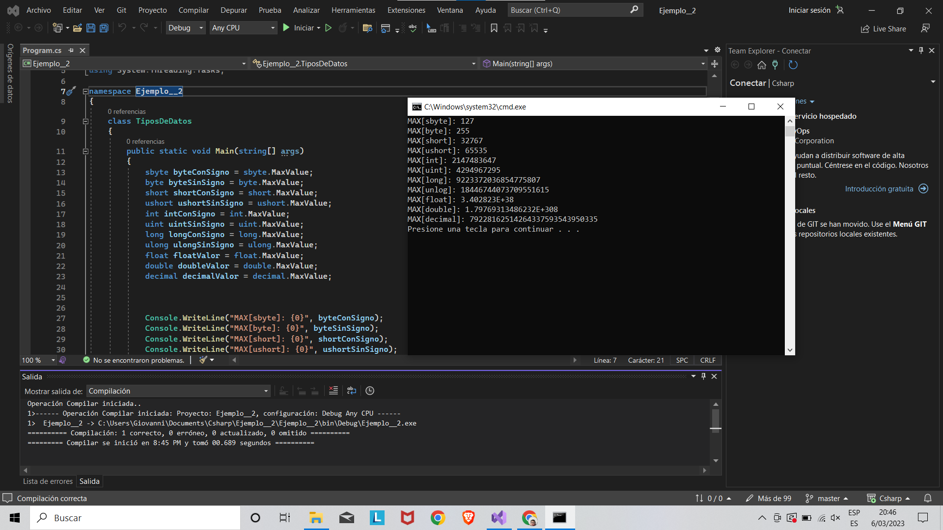

Slide 3
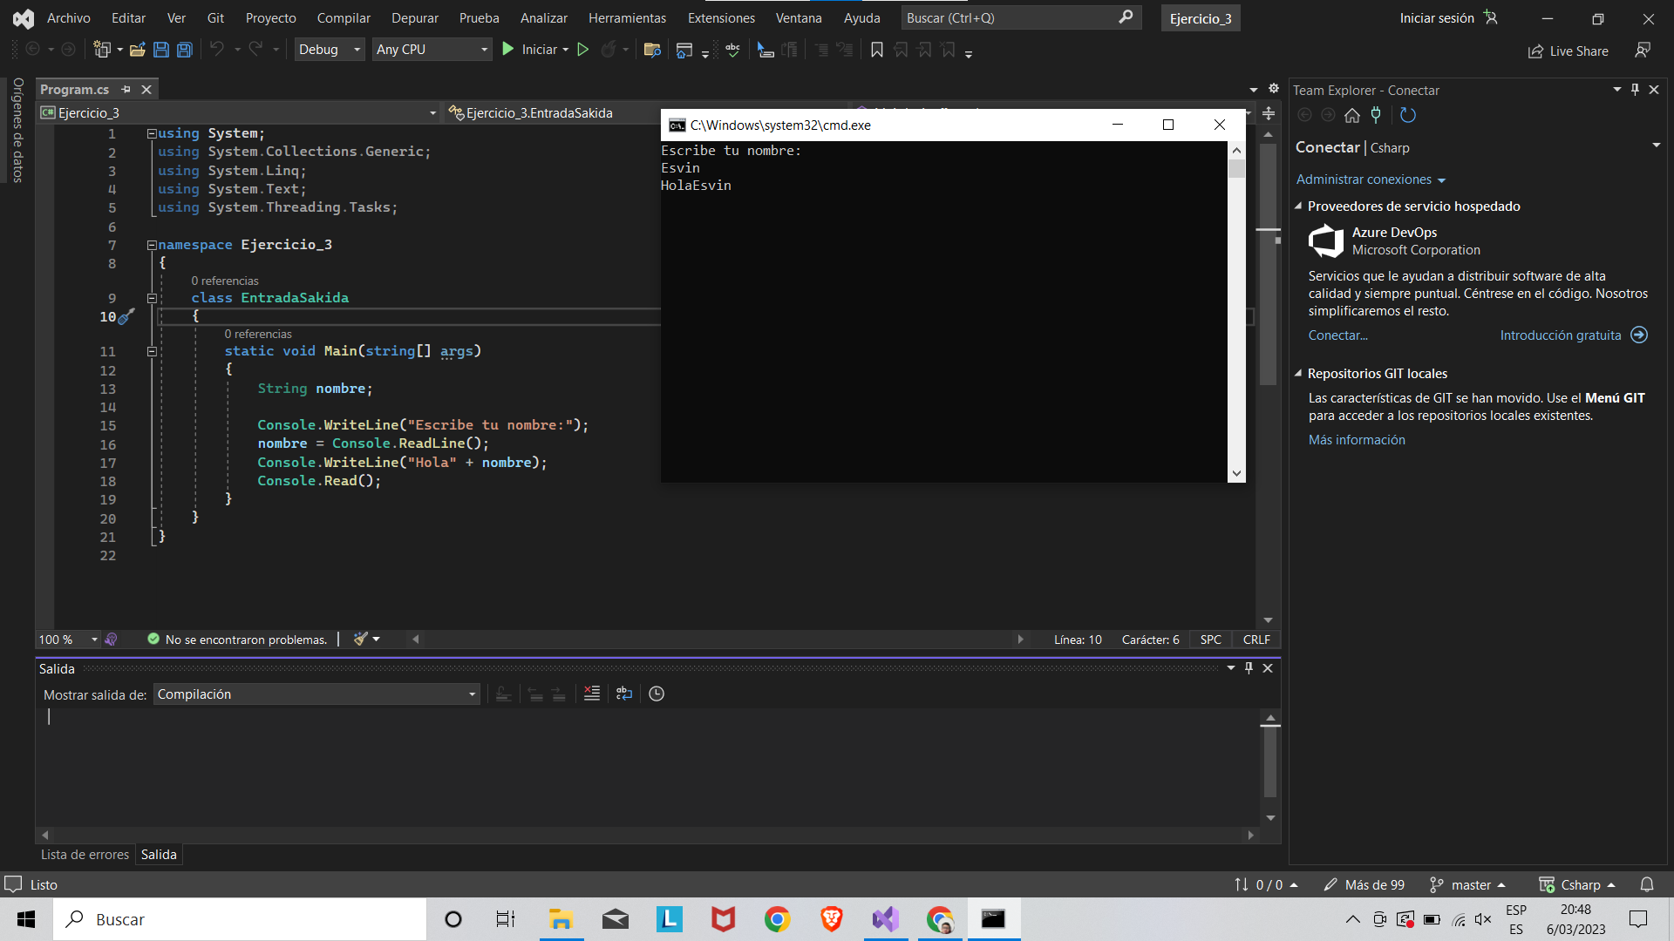

Slide 4
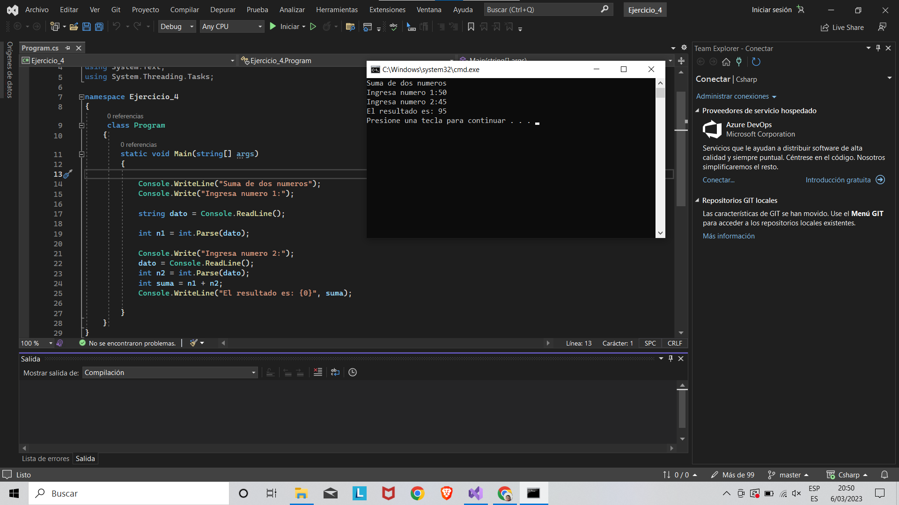

Slide 5
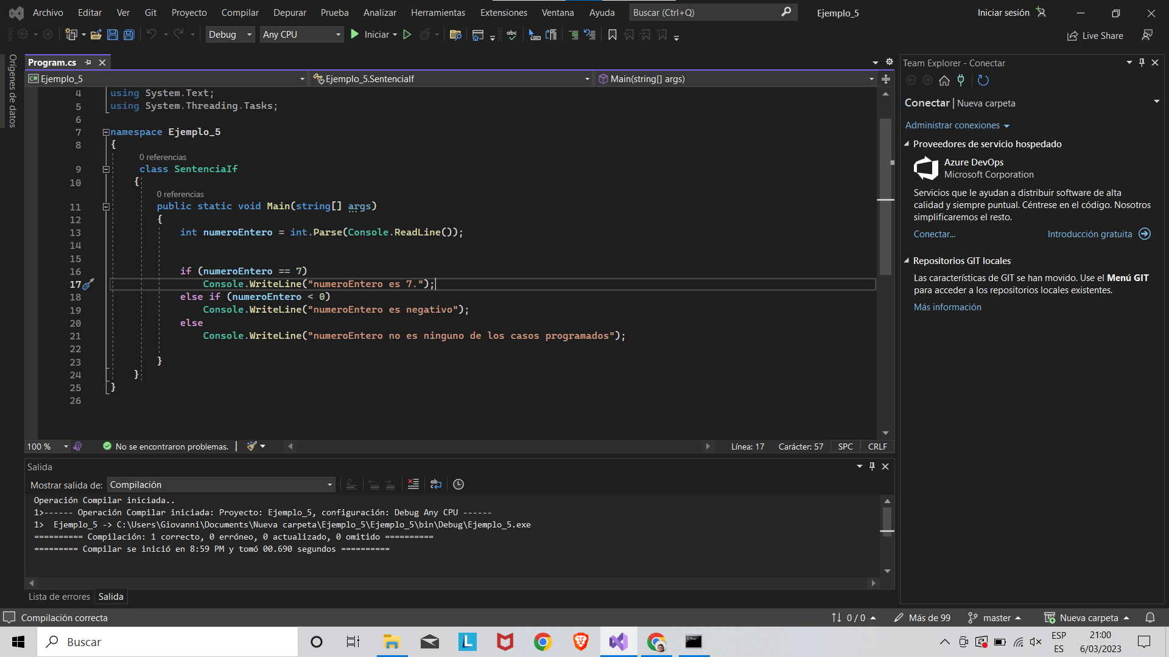

Slide 6
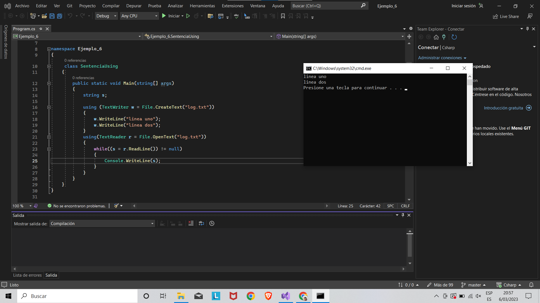

Slide 7
LINK DE GOOGLE DRIVE
https://docs.google.com/presentation/d/1i1Bg8dvW5ptElRDW98HDQzQTwmwCI4P0/edit?usp=share_link&ouid=101933366886777696768&rtpof=true&sd=true

